Slide 1
Software Development, Variables, Working with User Input & Math Operators
CSCI-UA.0002
Introduction to Computer Programming

Slide 2
Day 02 Agenda
Tutoring update
Software development cycle
Python Fundamentals
Controlling output
Variables
The 'input' function
Math expressions
Assignment 01

Slide 3
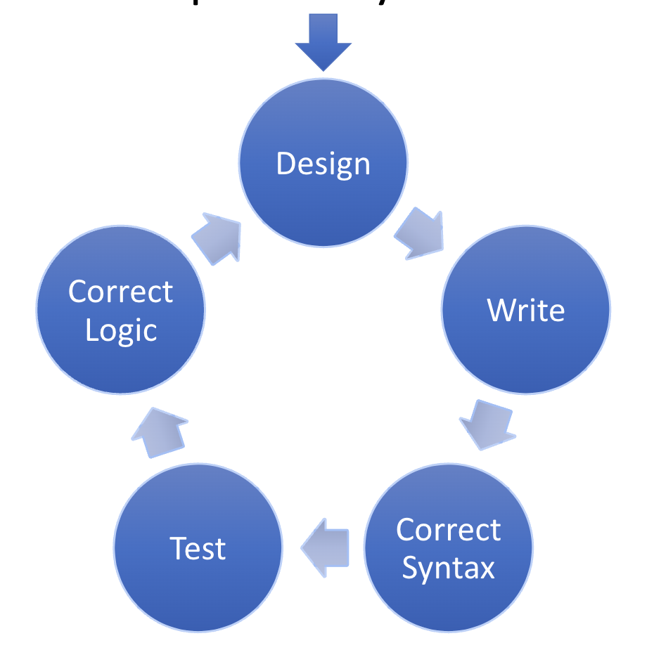
Software Development Cycle

Slide 4

Design
Programmers need to establish a solid foundation before they begin coding a project
This involves understanding the task that the program must perform
Next, we need to determine the steps that need to be taken in order to perform the task

Slide 5
Determining the Steps Needed to Perform a Task
To do this we need to break down the task into a series of concrete steps that can be followed (like a recipe)
Remember that computers need each step to be broken down into minute detail
Computers don't have the ability to infer intermediate steps like we can, so we need to be explicit in what we ask our programs to do

Slide 6
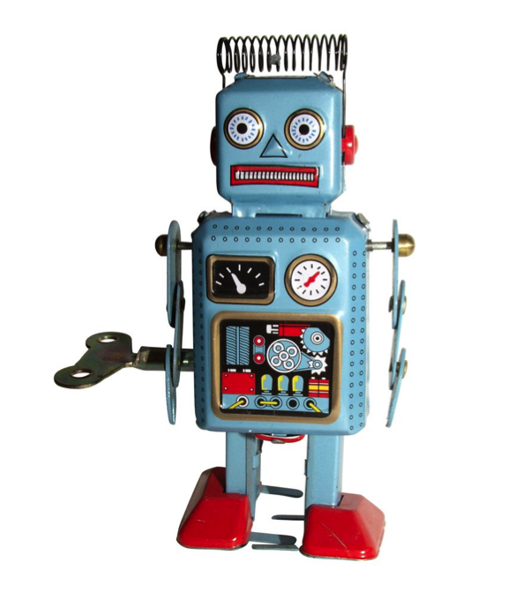
Craig the Robot

Slide 7
Algorithms
"A series of well defined, logical steps that must be taken in order to perform a task"
Algorithms serve as a necessary intermediate step between understanding the task at hand and translating it into computer code

Slide 8
Pseudocode
A useful technique for breaking down an algorithm into meaningful chunks and aligning them with the toolset of a language
With pseudocode we describe our program using a spoken language. For example:
Ask the user for two numbers
Ensure that they are both decimal values
Add the numbers together
Output the sum formatted to decimal places
In pseudocode we don't have to worry about program syntax, but instead focus on the action items we need to perform to accomplish a specific task

Slide 9
Flowcharts
A graphical model that helps programmers conceptualize the task at hand.
Flowcharts are often useful to get a birds-eye view of your design when your program contains many "branches"

Slide 10
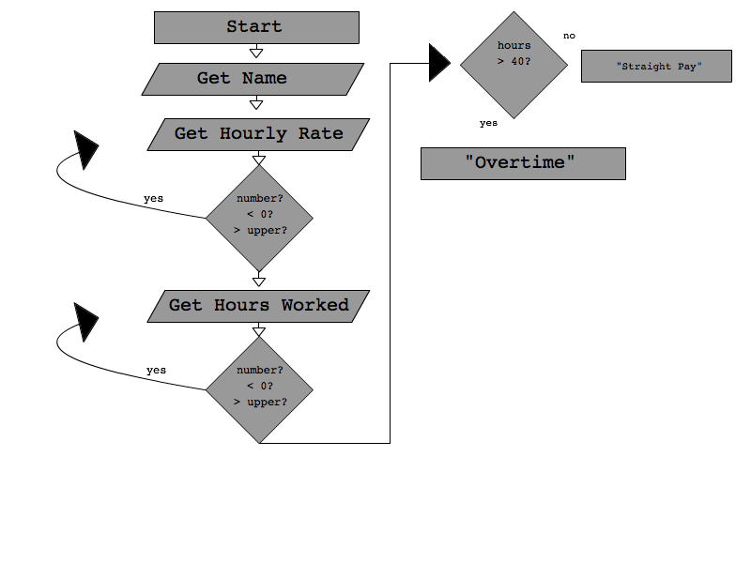
Flowchart Example

Slide 11
Input, Processing & Output
Programs typically perform the following 3 steps
INPUT is received
Some kind of PROCESSING is performed
OUTPUT is produced

Slide 12
Input
Can be from a variety of sources
User: keyboard, mouse, etc.
Hardware: scanner, camera, etc.
Data: file, the Internet, etc.

Slide 13
Processing
A series of mathematical or logical processes are applied to the input
Compare values
Add, multiply, divide or subtract numbers
Perform calculations on an item over and over again (i.e. blurring an image)

Slide 14
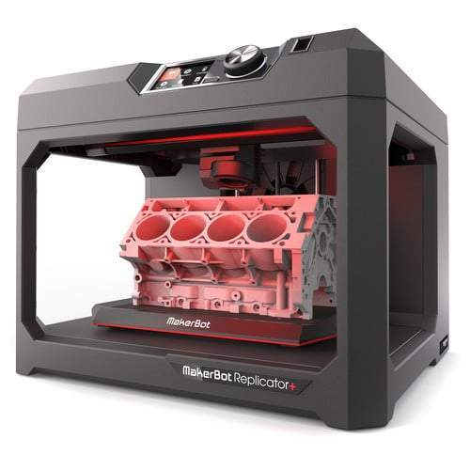
Output
Some kind of tangible / visible / readable product is constructed
Printout
Screen display
3D fabrication

Slide 15
Any questions?
…. then on to Python!

Slide 16
IDLE: Getting Started
IDLE: Integrated DeveLopment Environment
Has two modes
Interactive – commands are immediately processed as they are received
Script – allows to write a program (saved as a "text file" on your computer) and have your commands processed whenever you'd like
We will mainly be using "script" mode during this semester

Slide 17
IDLE: Creating a new program
Open IDLE
Click on File -> New Window
Click on File -> Save
Save your file somewhere on your computer. You will need to add the '.py' file extension to your file if IDLE does not place it there automatically.
With your program open, click on Run -> Run Module
If you need to open your program you can click on File -> Open and browse to find the desired Python source file (.py

Slide 18
Ed Stem: Getting Started
You can also write and run code in a web-based environment like Ed Stem
This will allow you to not worry about storing files on your computer, though you will lose access to Ed Stem if you are not online
Here's how to run a program using this tool:
Log into our Brightspace site
Click on the 'Content' area
Find the link to 'Ed Stem' and click on it
Navigate to the 'Workspaces' area (looks like a '_>' button at the top of the page)
Create a new workspace, or open an existing one
You can create new files by clicking the "+" button on the left side of the page
You can run these files by clicking on the terminal button (smaller '_>' button) and typing the following command: python3 filename … where filename is the name of the file you want to run. For example: python3 myfile.py

Slide 19
Functions
A "function" is a pre-written piece of computer code that will perform a specific action or set of actions
Python comes with a number of built-in functions, and you can also write your own (more on that later in the semester)
Functions always begin with a keyword followed by a series of parenthesis.
Ex: print()

Slide 20
Function Arguments
You can "pass" one or more "arguments" into a function by placing data inside the parenthesis
Ex: print('Hello, World!')
Different functions "expect" different arguments. The print function, for example, expects you to pass it a series of values that you wish to print to the screen
When you ask Python to run a function we say that you have "called" the function.

Slide 21
Strings
Data that is textual in nature (i.e. "Hello, World!") is called a "String"
Strings can contain 0 or more printed characters
"String Literals" are strings that you define inside your program. They are "hard coded" values and must be "delimited" using a special character so that Python knows that the text you've typed in should be treated as printed text (and not a function call)
Ex: print('hello, world!')
Python supports four different delimiters
The single "tick" ( ' )
The single quote ( " )
The triple quote ( """ )
The triple single quote (''')

Slide 22
Printing multiple arguments
The print function can accept zero or more more arguments
If you decide to pass multiple arguments to the print function you should separate them by a comma. Example: print("Hello! My name is", "Python")
The order of your arguments matters. Reversing the arguments above will produce very different output. We refer to these kinds of arguments are "positional" arguments
Note that when Python executes the function call above it will insert a space between the two arguments for you automatically.
Also note that the print function will automatically add a line break after it prints the last argument it was passed. We will discuss how to override this behavior in our next class.

Slide 23
Line endings
When using the print() function you probably have noticed that Python automatically places a newline character at the end of each line
You can override this behavior and have Python use a character of your choice by using the optional 'end' keyword argument when using the print() function
Example: print('one', end='') print('two', end='')

Slide 24
Separating print() function arguments
By default, Python will place a space between arguments that you use in print() function calls
You can override this behavior by using the optional 'sep' argument
Example: print('one', 'two', sep='*') # output: one*two

Slide 25
Combing both line endings and separators
You can use both the 'sep' and the 'end' arguments at the same time in the same print() function call.
Example: print('a', 'b', 'c', sep='*', end='')
Note that keyword arguments must come at the end of your argument list after any positional arguments.

Slide 26
Poll Everywhere Check-in

Slide 27
Escape Characters

Slide 28
Escaping Delimiters
Most programming languages support an "escape character" that allows you to perform special actions inside the confines of a delimiter.
In Python the escape character is the "\" character
It causes Python to treat the next character as a "special" character – in most cases this means that you will ignore the next character and prevent it from interfering with your delimiter
Example: print('Hi, I\'m Pikachu, a Pokemon')

Slide 29
Line Breaks
There are a number of special characters you can use in conjunction with the escape character to perform special string operations.
Example – "\n" – renders a line break. print ('line 1\nline 2\nline 3\n') # line 1 # line 2 # line 3

Slide 30
Tabs
"\t" – renders a tab: x = 5 y = 4 print ('X', '\t', 'Y', '\t', 'X*Y') print (x, '\t', y, '\t', x*y) X Y X*Y 5 4 20

Slide 31
Commenting

Slide 32
Commenting in Python
Your programs will eventually get to be very, very long
Commenting is a way for you to leave little "notes" for yourself so that you can understand what your thinking process was when you originally wrote your program
Python supports comments via the # symbol
You can use the # symbol to tell Python to essentially ignore anything that comes after the symbol
Examples: print('Hello, world!') # this will print the string Hello World # the following line will print a color print('Yellow')
It's important to get into the practice of commenting early and to be consistent about leaving comments throughout your program

Slide 33
Multi Line Comments
Python supports multi line comments through the use of the triple quote delimiter
Example: """ This line will be ignored So will this one And this one """ print('hi there')

Slide 34
Comments as Pseudocode
We sometimes use comments as a way to pseudocode a programming project before we launch into writing it using real code.
This allows us to outline the necessary tasks without having to be burdened with writing the actual code to accomplish the desired tasks. For example: # get two test scores from the user # add them together and divide by 200 # print out the result and report the average # score to the student

Slide 35
Comments as a debugging technique
Sometimes you may need to "turn off" a line of code in order to isolate an issue in your logic or syntax
You can use comments to cause Python to ignore portions of your code. For example: # welcome the user print ("Welcome to my program!") # no idea why this isn't working! :( # print ('I'm thrilled that you're here!")

Slide 36
Variables

Slide 37
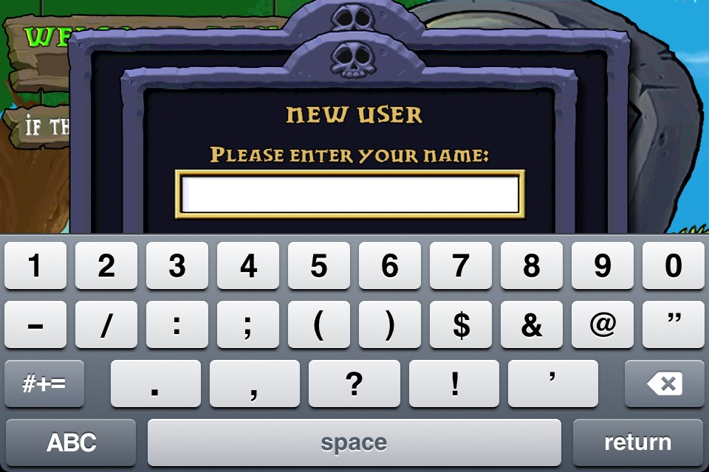
Plants vs. Zombies: New Game

Slide 38
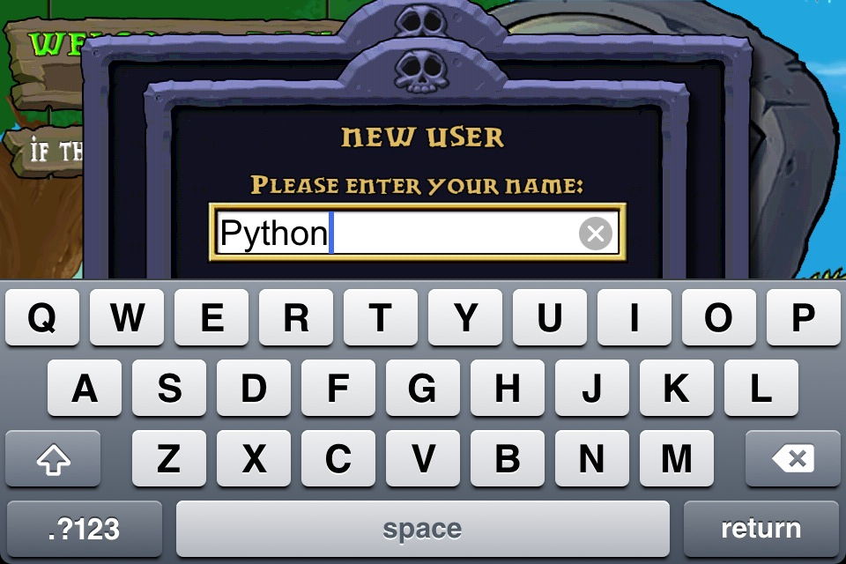
Plants vs. Zombies: Input Player

Slide 39
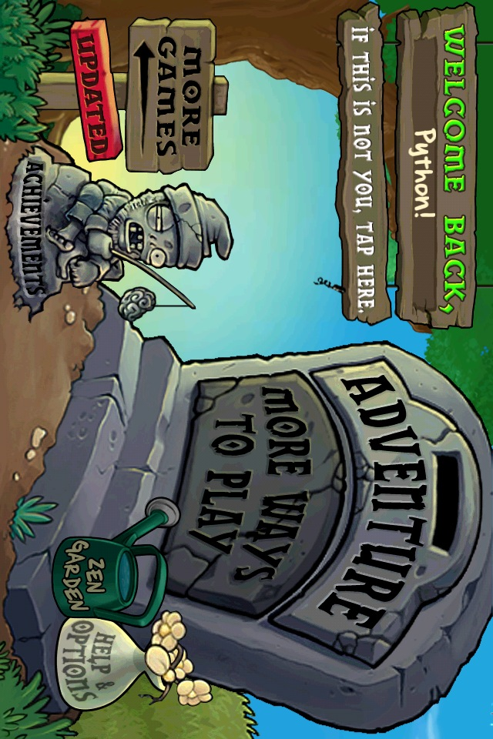
Plants vs. Zombies: Welcome Player

Slide 40
Variable Mechanics
Variables can be thought of as ”containers" that can store references to information in your computer's memory
You will be using variables constantly when writing your programs in order to keep track of various pieces of information
You can create a variable by using the following syntax:
variablename = somedata
Examples:
speed = 5
myname = 'Pikachu'
The '=' symbol is called the 'assignment operator' and will cause Python to store the data on the right side of the statement into the variable name printed on the left side

Slide 41
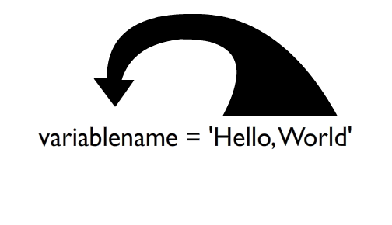
Variable Assignment Statement (name on the left, value on the right!)

Slide 42
Variable Naming Rules
You can't use one of Python's "reserved words" (see the next slide for a list)
Variables can't contain spaces (though you can use the underscore character ("_") in place of a space)
The first character of a variable name must be a letter or the underscore character. Any character after the first can be any valid alphanumeric character (or the underscore character)
Python is case sensitive

Slide 43
Python Reserved Words
False None True and as assert break class
continue def del elif else except finally for
from global if import in is lambda nonlocal not
or pass raise return try while with yield

Slide 44
Legal or Illegal variable name?
class = 2
class_avg = 125
classAvg = 99
_class_avg = 99
2ndclassavg = 125
classavg! = 99

Slide 45
Solution
class = 2
class_avg = 125
classAvg = 99
_class_avg = 99
2ndclassavg = 125
classavg! = 99
Illegal: "class" is a reserved word
Legal
Legal
Legal
Illegal: can't start with a number
Illegal: can only use alphanumeric values and the "_" symbol in variable names

Slide 46
Common Variable Naming Conventions
rockettopspeed = 1000
rocket_top_speed = 1000
rocketTopSpeed = 1000
# can be hard to read
# underscored
# "camel case"

Slide 47
Displaying Variables with the print function
You can print the data that is currently being held by a variable by passing the variable name to the print() function as an argument. Example: print(myvar)
As with string literals, you can tell the print() function to display more than one item in the same function call by separating your arguments with commas. Example: name_var = "Pikachu" print("Hello, my name is", name_var) >> Hello, my name is Pikachu

Slide 48
Reassigning Variables
Variables are called variables because they can "vary" the data that they store.
You can re-assign the value that a variable stores by simply using a second assignment statement. Example: dollars = 10.99 print('I have', dollars, 'in my account') dollars = 29.99 print('Now I have', dollars, 'in my account)

Slide 49
Multiple Assignments
It's possible to set the value of multiple variables on the same line. For example: x, y, z = 'a', 'b', 'c'
In this case the variables x, y and z will assume the values 'a', 'b', 'c' in that order
You can also assign the same value to multiple variables at the same time by doing the following: # a, b and c will all contain the integer 100 a = b = c = 100

Slide 50
Programming Challenge
You're working on a simple inventory management system for a small store. You'd like to store the name and price of two different products and print them out in the following format. Make sure your output matches the following exactly: Item: Bread Price: $ 2.99 Item: Eggs Price: $ 1.99

Slide 51
Python f-Strings
Newer versions of the Python language (version 3.6 and above) supports a new way to format variables & string literals.
This technique is called Literal String Interpolation, f-strings or “formatted” strings
The technique allows you to include a variable inside of a string literal using the following syntax: a = 5 b = 10 print(f"a is holding {a} and b is holding {b}") # output a is holding 5 and b is holding 10
Note how the string begins with the letter “f” outside of the delimiter – this tells Python that the string can include variables that are further delimited using curly braces

Slide 52
Data Input

Slide 53
Hard-coded Values
So far we have learned how to:
OUTPUT information (via the print function)
STORE information (via variables)
However, all of our programs have been "hard coded," meaning that we have predefined the operating environment using information that we ourselves have defined. Example: myname = 'Pikachu' print('Welcome to my program', myname)

Slide 54
Reading Input from the Keyboard
You can make your programs more interactive by involving the user in the process
One of the simplest ways to do this is to request information from the keyboard using the input() function.
Example: # ask the user their name username = input('What is your name?') # welcome them! print('Welcome,', username)

Slide 55
The Input function
Input is a built-in function
It accepts one argument – a String
It then prompts the user with that string and waits for them to type in a series of characters. Your program will resume when the user hits the ENTER key
Whatever the user typed in during that time is sent back to your program as a string. You can store that string in a variable. Example: user_age = input('How old are you?')

Slide 56
The Input function "returns" a String
The input() function always "returns" a String.
This means that the output it generates is a string, and when you store that output in a variable it will be treated as though it is a string.

Slide 57
The Input function & the assignment operator
Note that these two line work using the same mechanics: var1 = "Blue" var2 = input("What is your favorite color?")
In the first line of code we are assigning the String Literal into the variable 'var1'
In the second line of code we are assigning the RESULT of the input function into the variable 'var2'
Both 'var1' and 'var2' will be filled with data after these lines execute

Slide 58
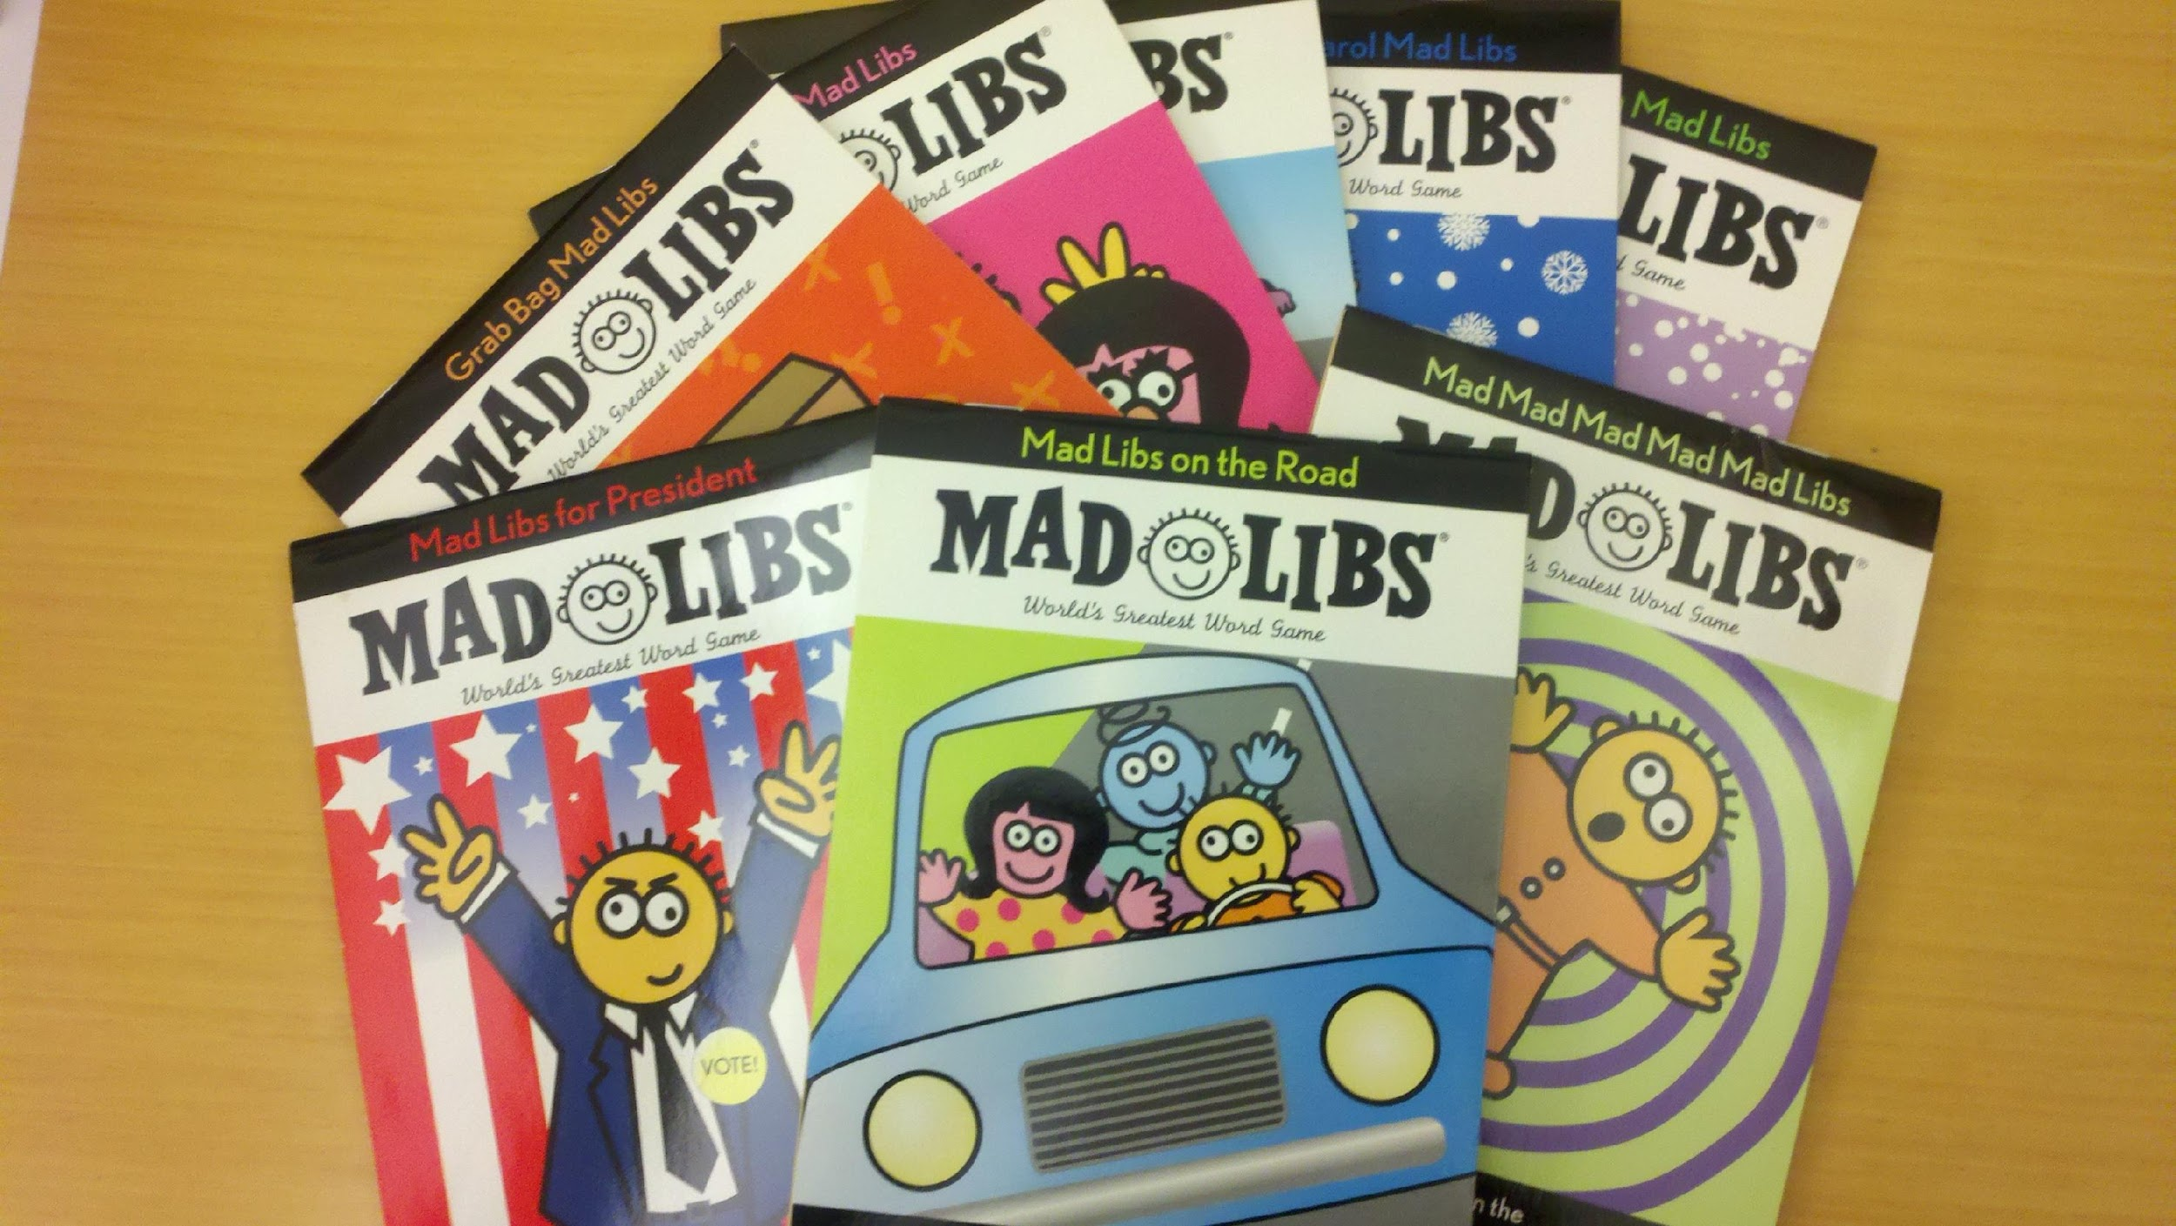
Let's give it a try …

Slide 59
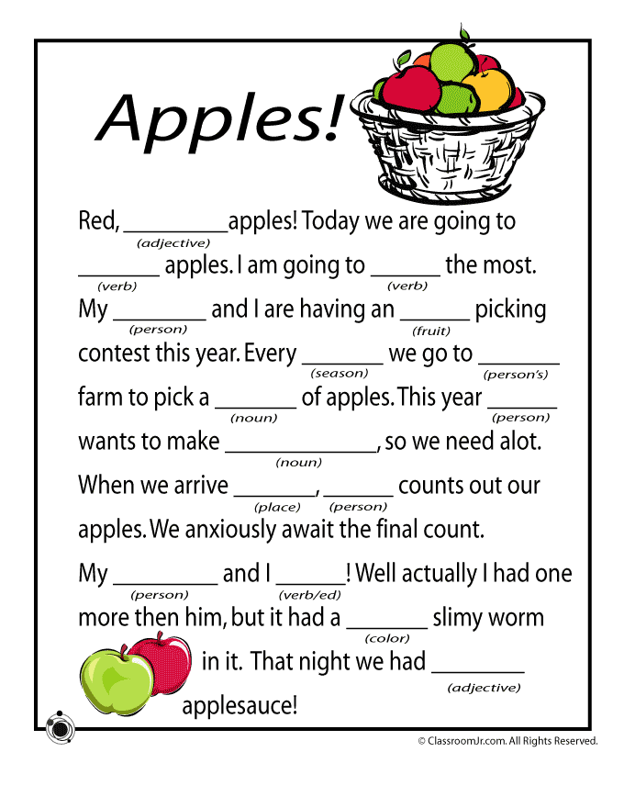
Mad Libs Input

Slide 60
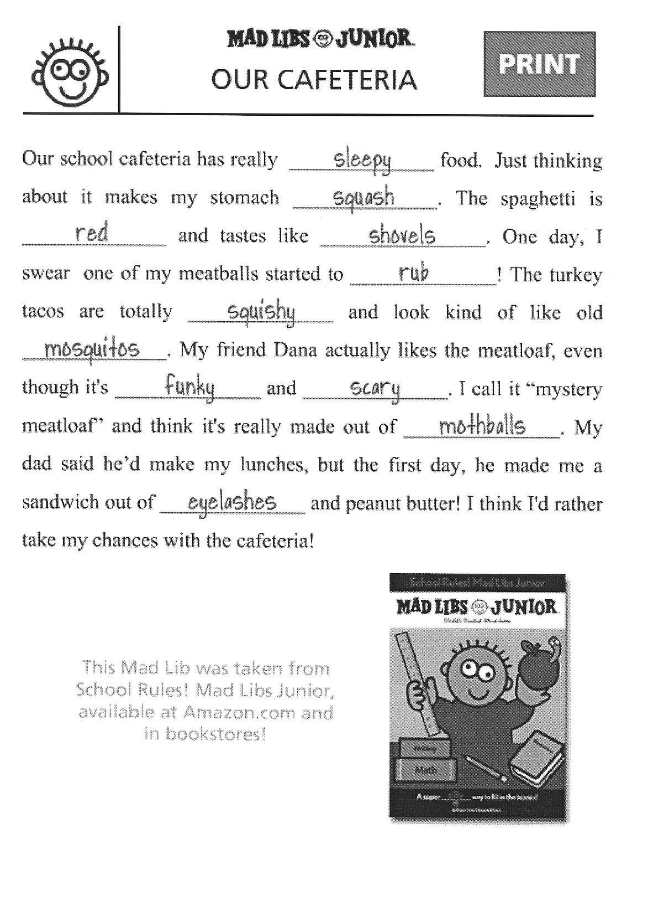
Mad Libs Output

Slide 61
In-class programming exercise
Write a program that asks the user to type in 4 different words using the following prompts: enter a noun enter a verb enter an adjective enter an adverb
Use the input to output a "Mad Libs" paragraph using the following text: The [adjective] [noun] was very hungry, so it decided to [adverb] [verb] to the nearest restaurant.

Slide 62
Performing Calculations

Slide 63
Performing Calculations in Python
Algorithms generally require some kind of calculation to be performed
All programming languages have tools for manipulating numeric data – we generally call these "math operations"

Slide 64
Python Math Operations
Operation
Operator
Addition
Subtraction
Multiplication
Division (floating point)
Division (integer)
+
-
*
/
//

Slide 65
Math Expressions
We use operators along with numeric data to create "math expressions" that Python can "evaluate" on our behalf

Slide 66
Math Expressions: Syntax
5 + 2
7 – 6
2 * 3
6 / 2
6 + 2 - 12
operator
operand
operand

Slide 67
Outputting math expressions
print(5+2)
print(100 * 5 – 12)

Slide 68
Storing the results of an expression
answer = 5 + 2
print('the answer to 5 + 2 is', answer)

Slide 69
Using variables in math expressions
Math expressions don't necessarily need to involve only numeric literals
Example: price = 100.00 sales_tax = 0.07 total = price + sales_tax*price

Slide 70
Assignment #1

